Slide 1
Machine Learning
project
Under the Supervision of :
DR. Ali Hamza
Eng. Ahmed Nousir

Slide 2
Introduction
Brief overview of the significance and applications of machine learning in today's data-driven world.
Project Scope and Objectives
Highlighting the four internal projects:
CNN Classification on Augmented Alzheimer
Classification on Weather
Clustering on Online Retail
Regression on Student Scores

Slide 3
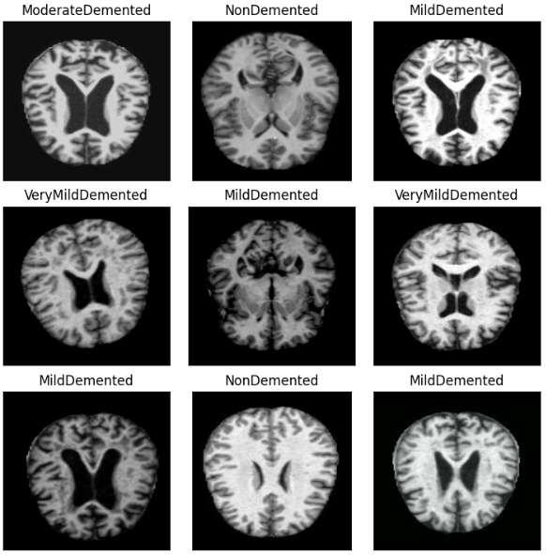
CNN Classification on Augmented-Alzheimer
The dataset
The "augmented-alzheimer-mri-dataset" is likely an enhanced dataset for Alzheimer's disease research. It includes high-resolution MRI scans of both Alzheimer's patients and healthy individuals, annotated with relevant information. The term "augmented" implies additional features or samples to improve dataset quality. Researchers use it to develop and evaluate machine learning models for early Alzheimer's detection.

Slide 4
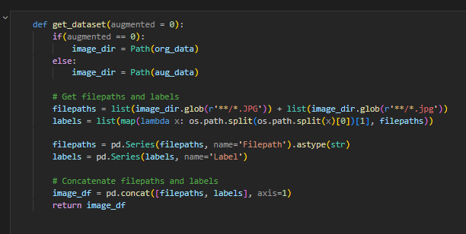
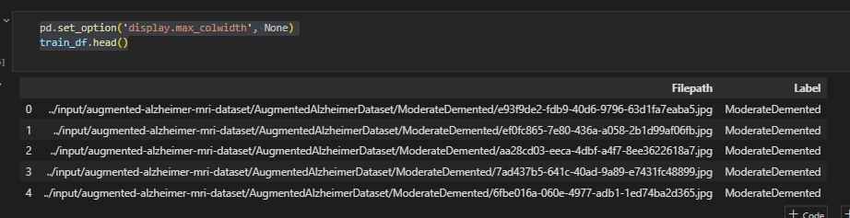
CNN Classification on Augmented-Alzheimer
About data
If the augmented parameter is set to 0, it uses the original dataset; otherwise, it uses the augmented dataset. It then retrieves the file paths for JPG images and their corresponding labels, combines them into a Data Frame, and returns it

Slide 5
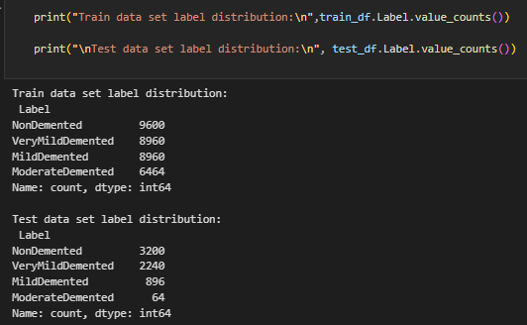
CNN Classification on Augmented-Alzheimer
About data
The distribution of the train and test data
This cell is vital for grasping dataset composition regarding label distribution. Understanding each class's sample counts is crucial to assessing dataset balance, impacting machine learning model performance. Imbalanced datasets may cause a bias towards more frequent classes, influencing decisions on data sampling, model evaluation metrics, and the potential use of techniques like data augmentation or class weighting in model training. assessing

Slide 6
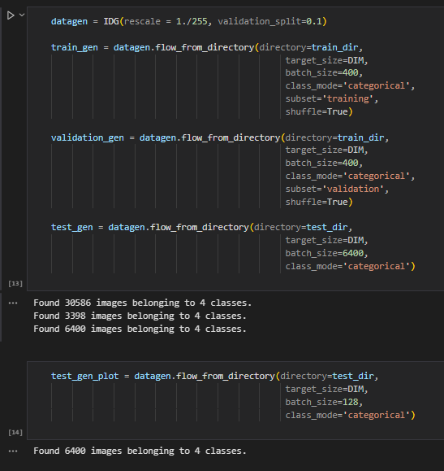
CNN Classification on Augmented-Alzheimer
Splitting the data
An ImageDataGenerator (datagen) is initialized for real-time data augmentation, rescaling images, and splitting the training data for validation.
train_gen and validation are data generators for training and validation datasets, respectively, created from the augmented data.
test_gen and test_gen_plot are data generators for the testing dataset, created from the original data.

Slide 7
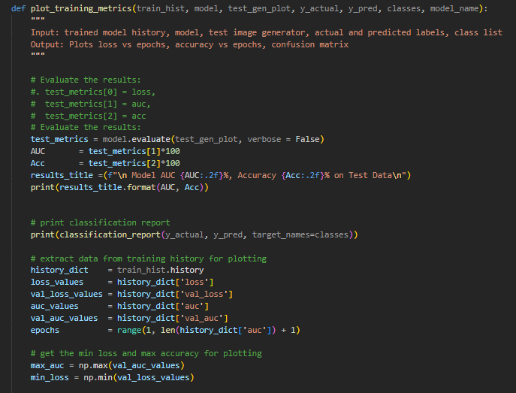
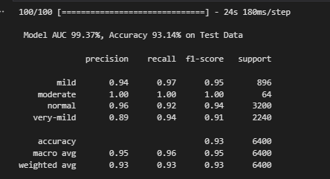
CNN Classification on Augmented-Alzheimer
Plotting the accuracy

Slide 8
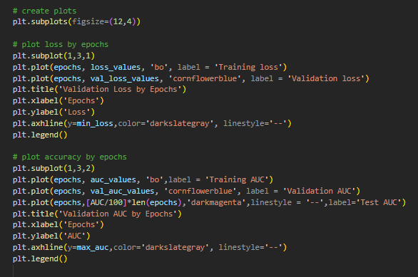
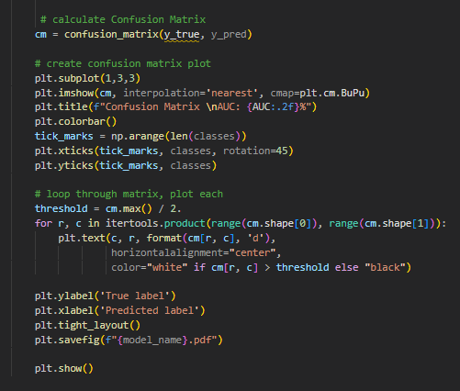
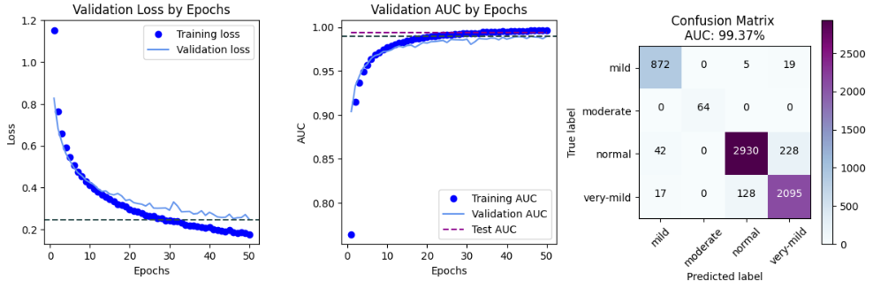
CNN Classification on Augmented-Alzheimer
Plotting the accuracy

Slide 9
CNN Classification on Augmented-Alzheimer
Models and Accuracy
Models | Accuracy
MobileNet | 95.17
VGG16 | 94.67
VGG19 | 93.14
DenseNet169 | 93.03
DenseNet121 | 92.64
Xception | 91.86
InceptionV3 | 90.16
MobileNetV2 | 90.06
ResNet101 | 84.20
ResNet50 | 76.66

Slide 10
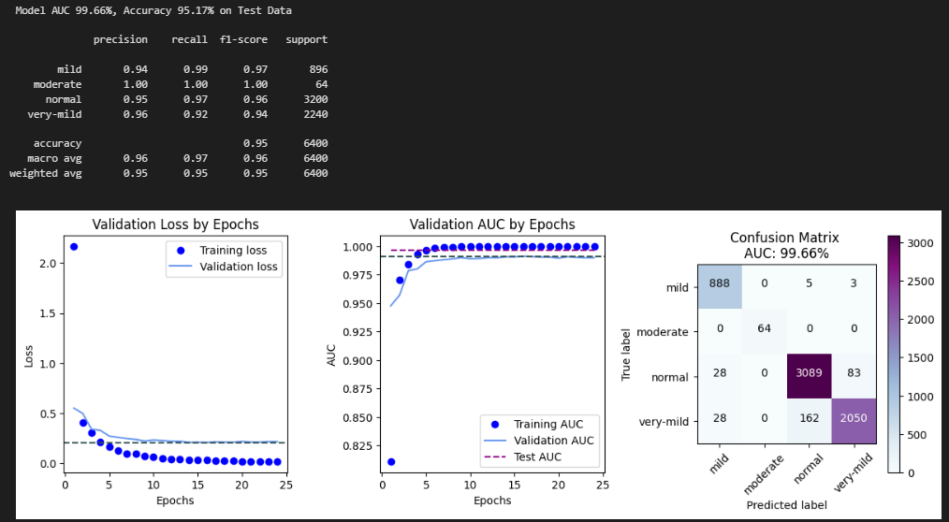
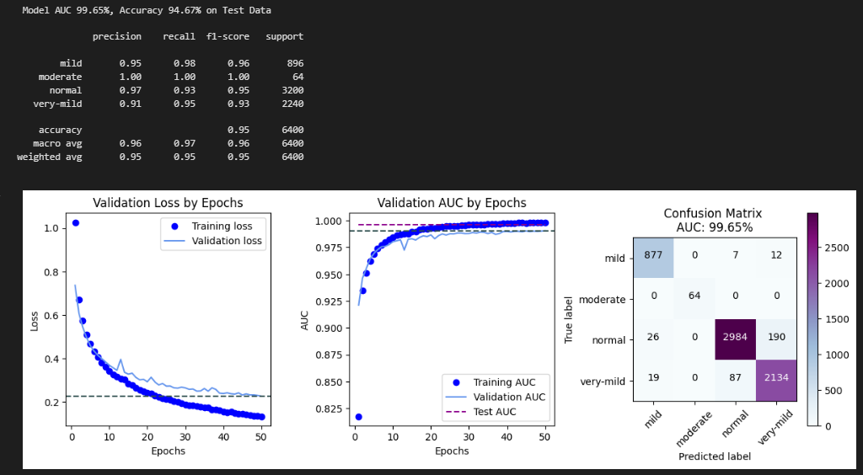
CNN Classification on Augmented-Alzheimer
Best 2 Models
MobileNet
VGG16

Slide 11
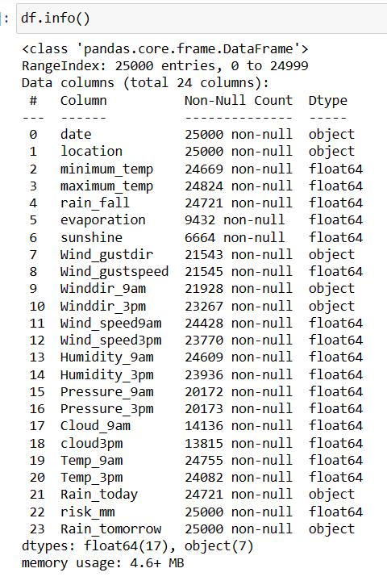
Classification on weather
The dataset
The weather dataset presents a detailed record of meteorological conditions, encompassing various parameters crucial for understanding daily weather patterns. The dataset spans different locations and includes observations over time, providing insights into temperature, rainfall, wind speed, humidity, pressure, cloud cover, and precipitation forecasts, By exploring the relationships between these weather parameters, we gain a deeper understanding of the atmospheric conditions and can make informed predictions about future weather patterns, the data contain 25000 rows and 21 columns.

Slide 12
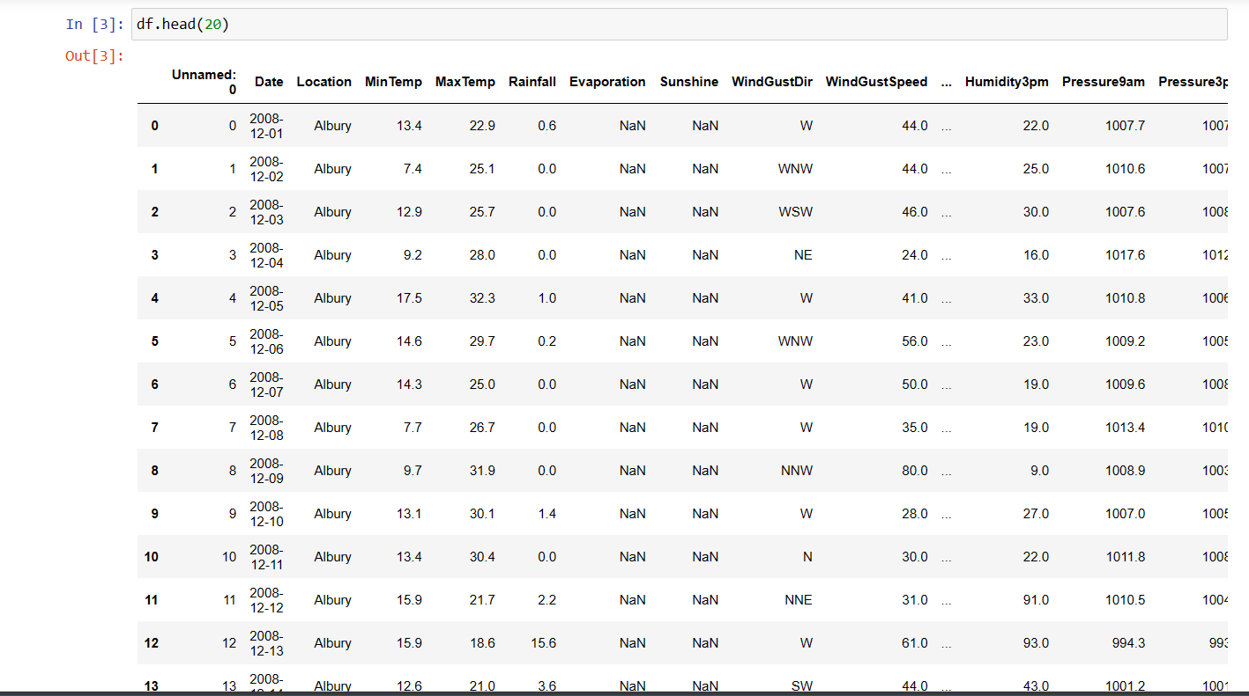
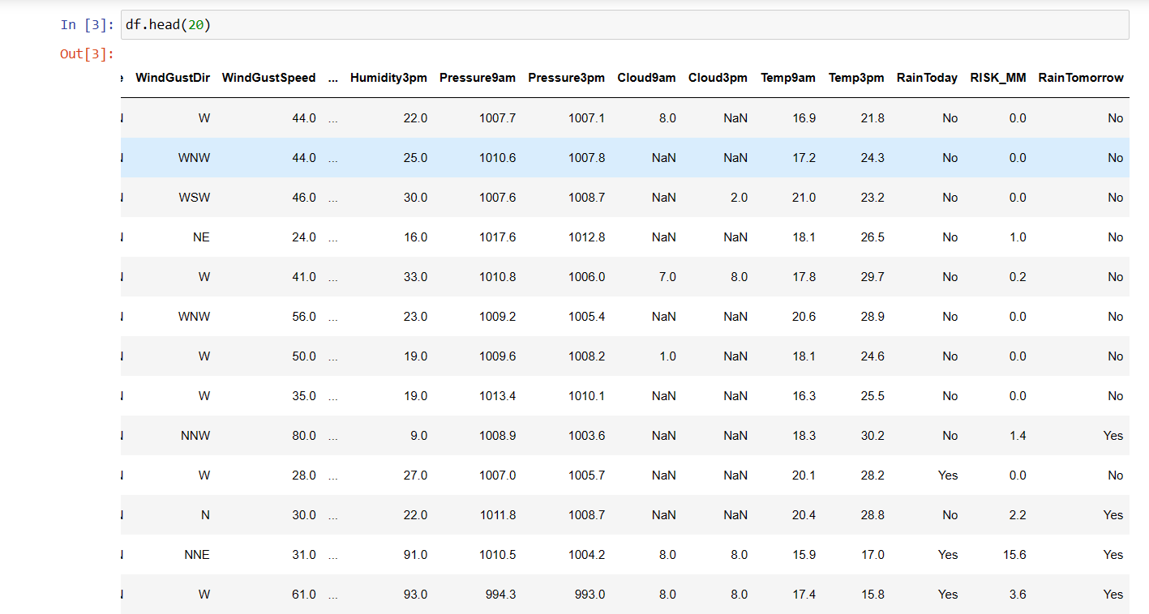
Classification on weather
About data

Slide 13
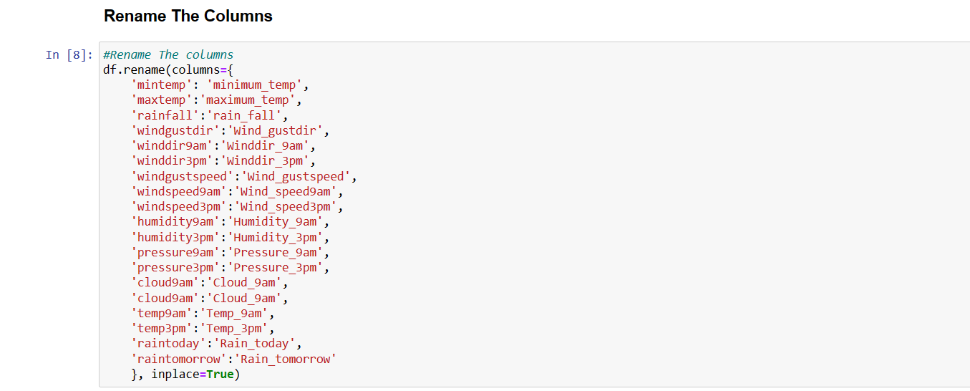
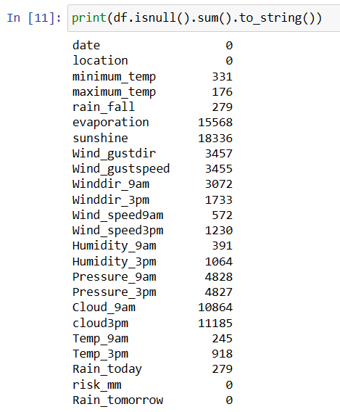
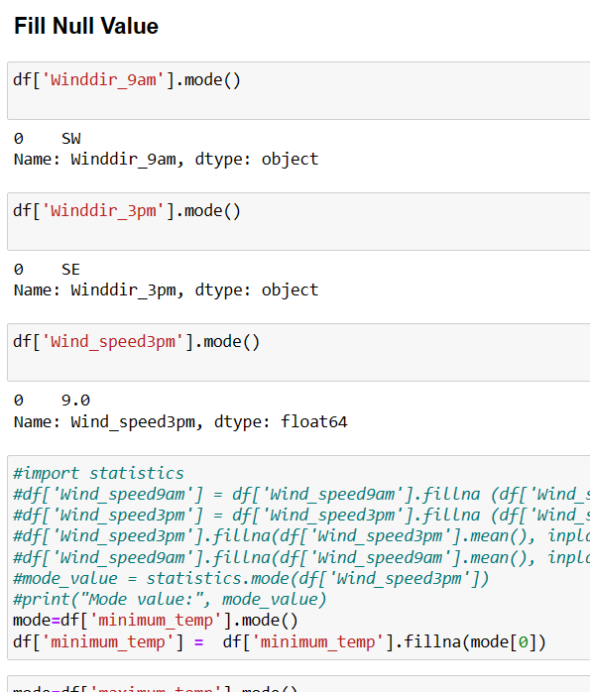
Classification on weather
preprocessing

Slide 14
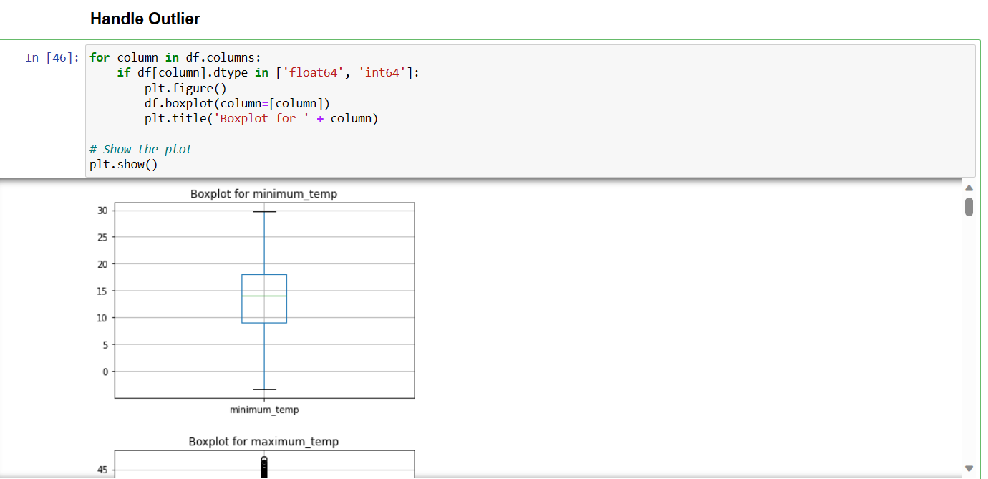
Classification on weather
preprocessing

Slide 15
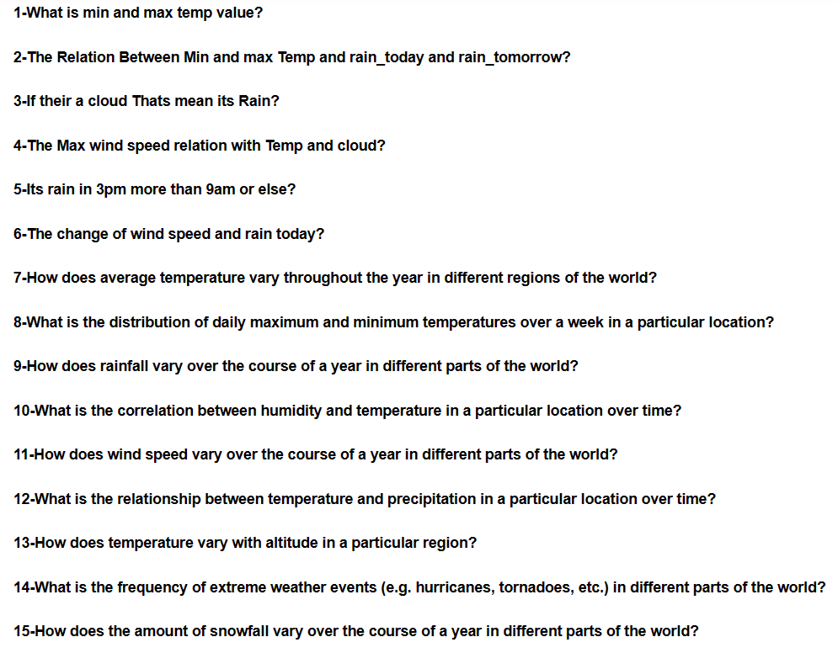
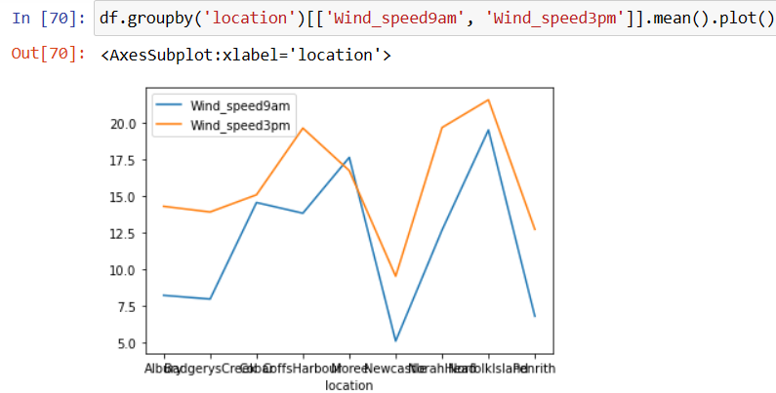
Classification on weather
Visualizing

Slide 16
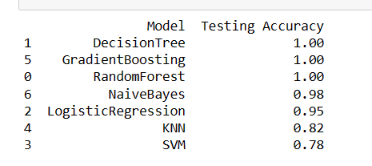
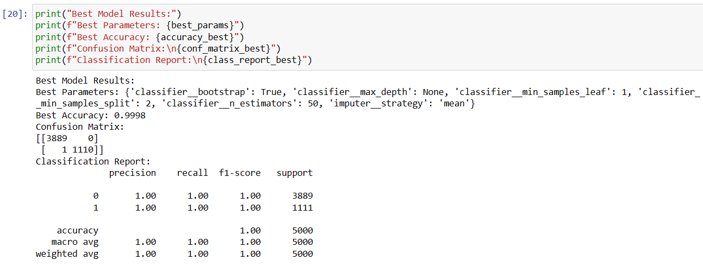
Classification on weather
Models

Slide 17
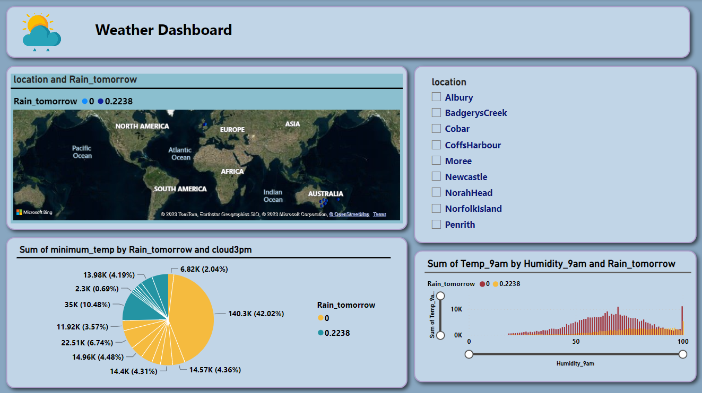
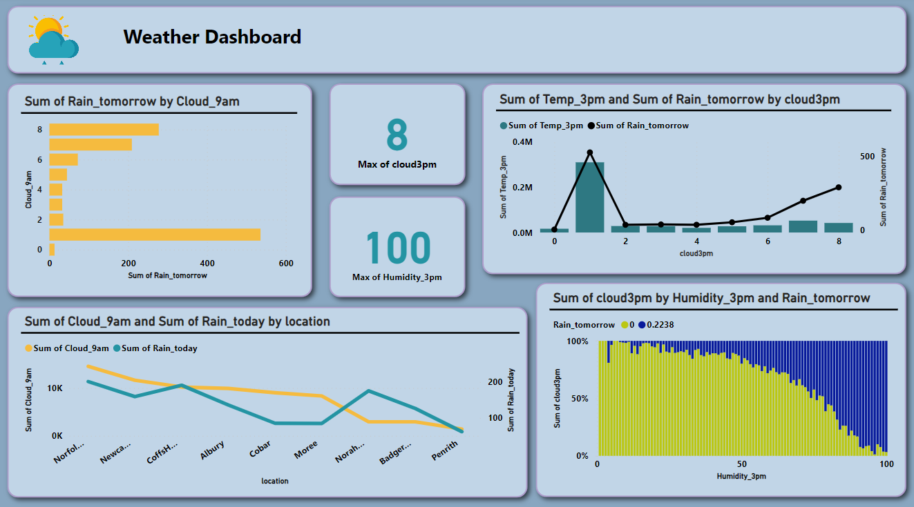
Classification on weather
Dashboard

Slide 18
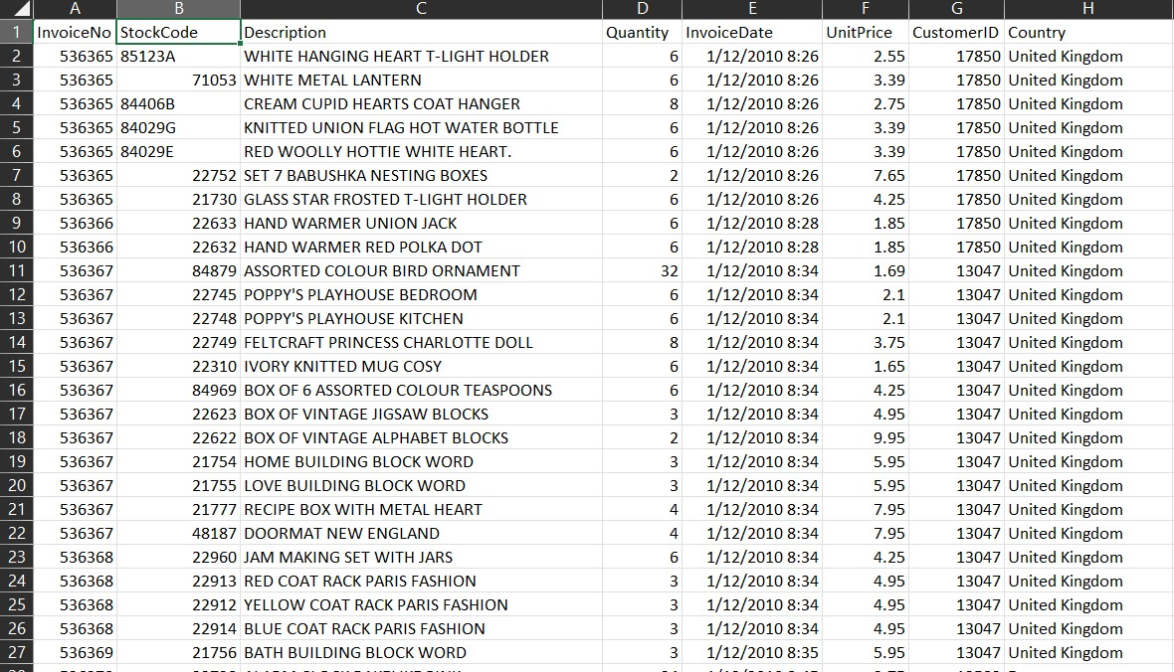
Clustering on online-retail
The dataset
In the digital age, businesses rely on customer segmentation to tailor marketing and allocate resources effectively. Amid the dynamic COVID-19-driven digital shift, fostering lasting customer relationships is paramount. By analyzing demographic, geographic, behavioral, and psychological data, businesses can personalize strategies for specific customer segments, boosting satisfaction and loyalty. Adapting customer engagement to the digital shift is critical, necessitating constant analysis of changing consumer behaviors. Thorough research and ongoing segmentation strategy refinement are crucial to minimize product launch risks, positioning businesses to meet evolving preferences successfully.

Slide 19
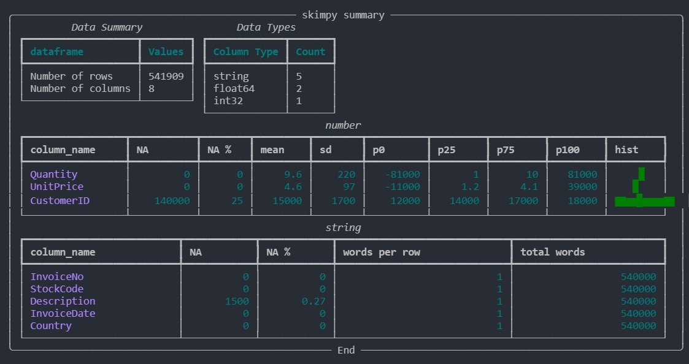
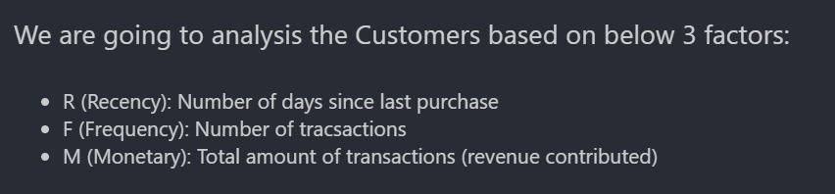
Clustering on online-retail
preprocessing

Slide 20
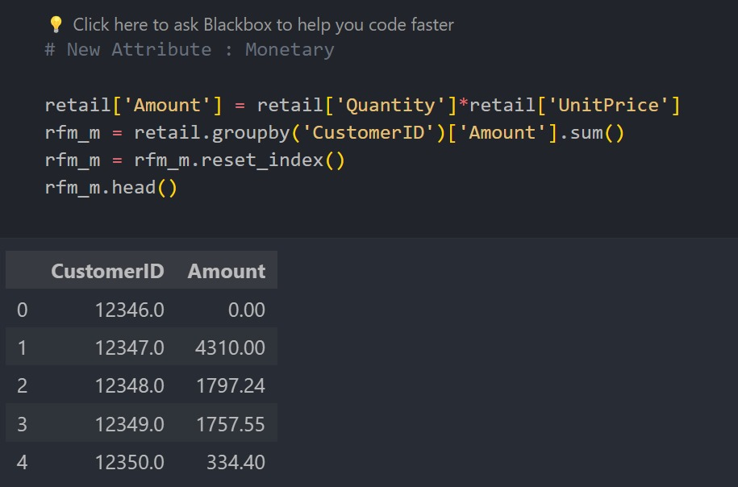
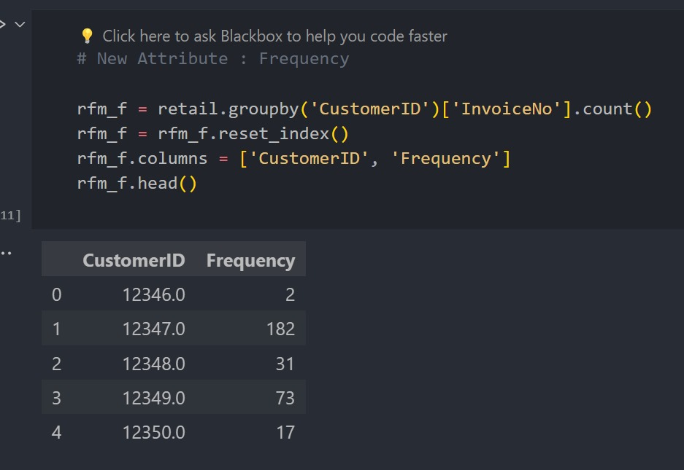
Clustering on online-retai
preprocessing

Slide 21
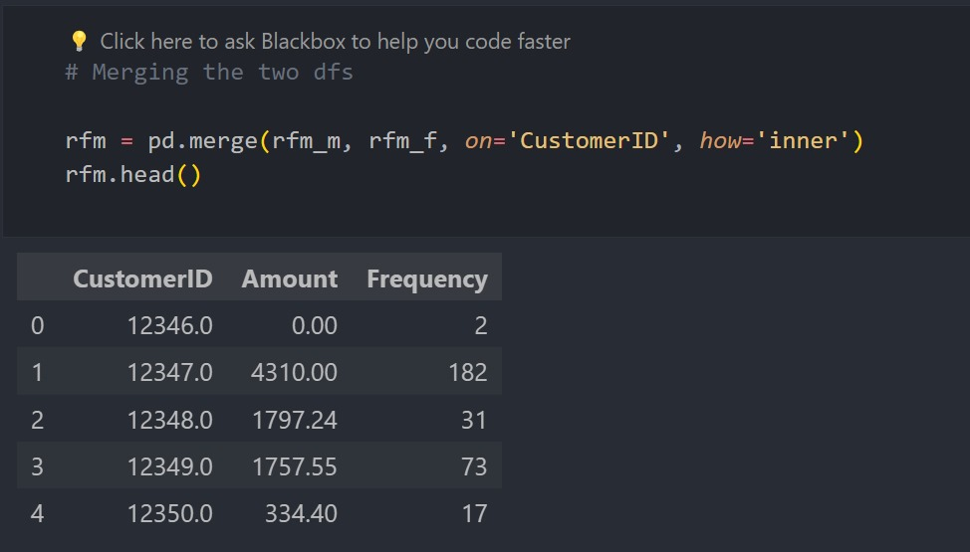
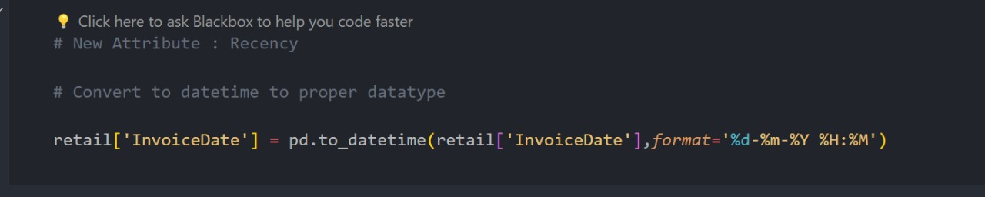
Clustering on online-retai
preprocessing

Slide 22
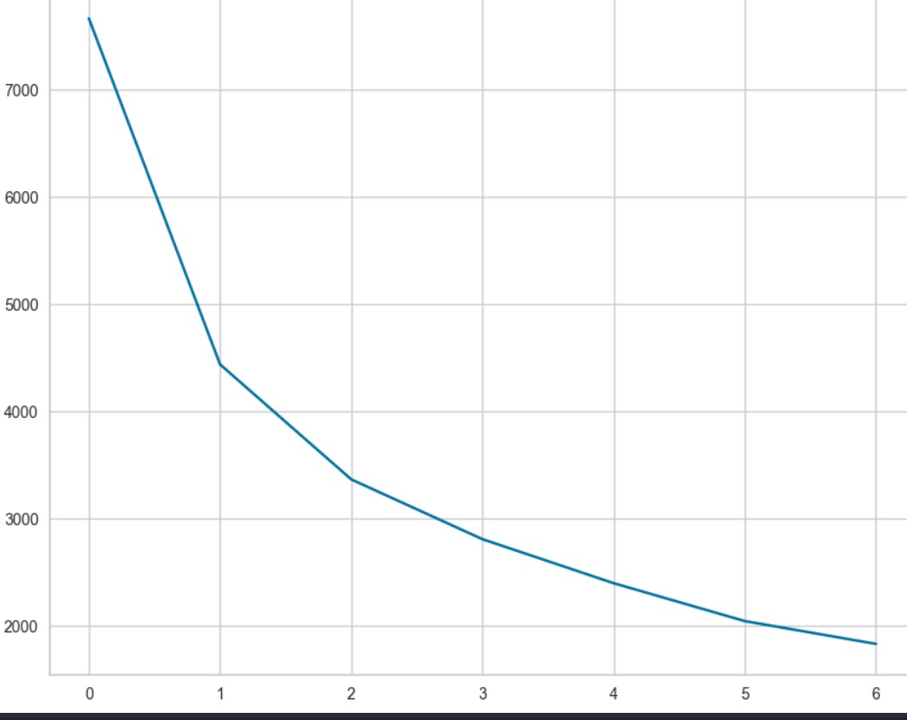
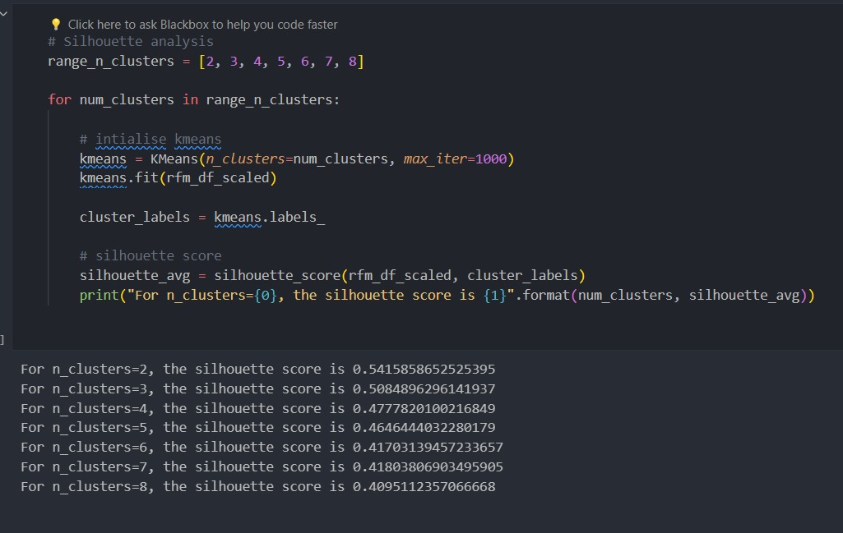
Clustering on online-retai
Cluster Model And Hierarchical

Slide 23
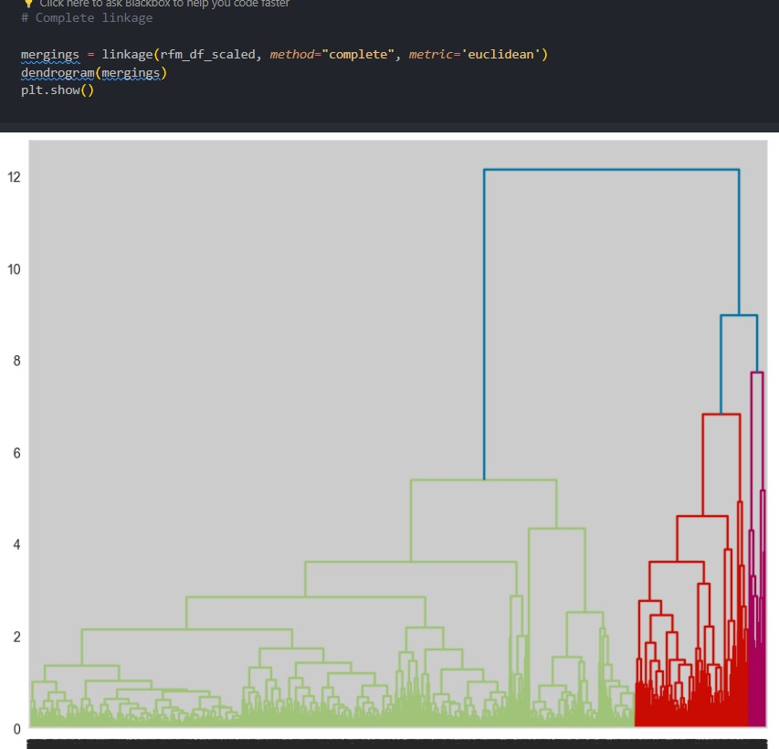
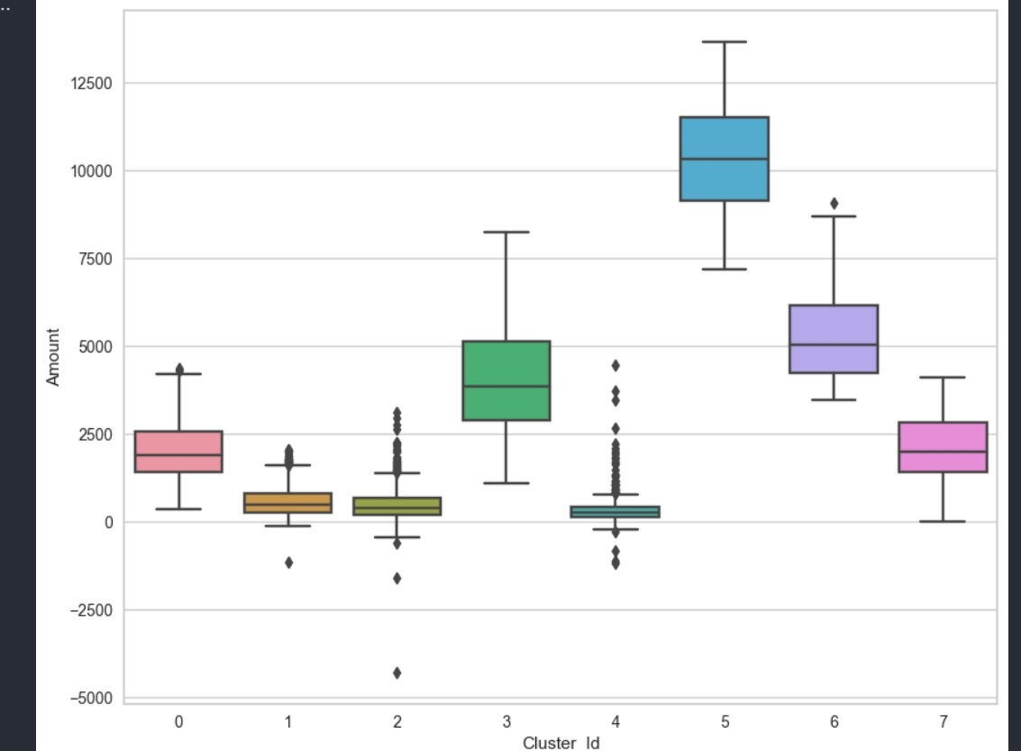
Clustering on online-retai
Cluster Model And Hierarchical

Slide 24
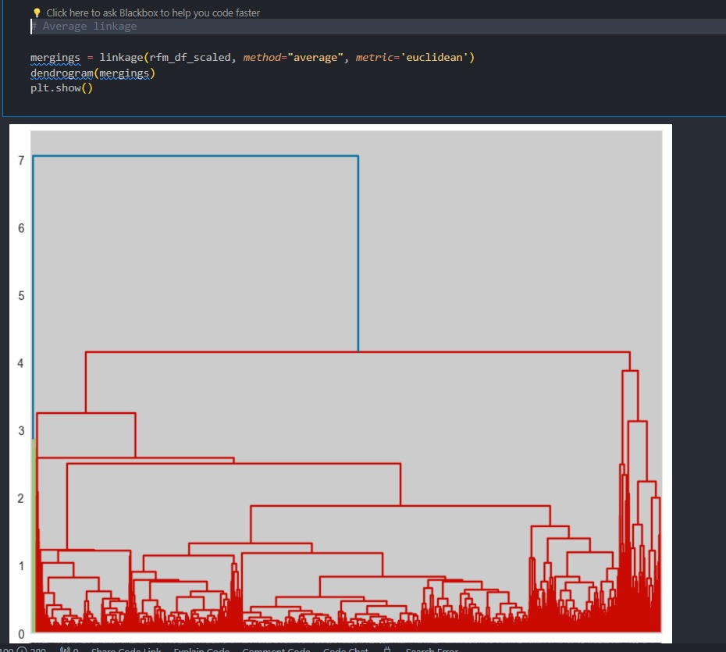
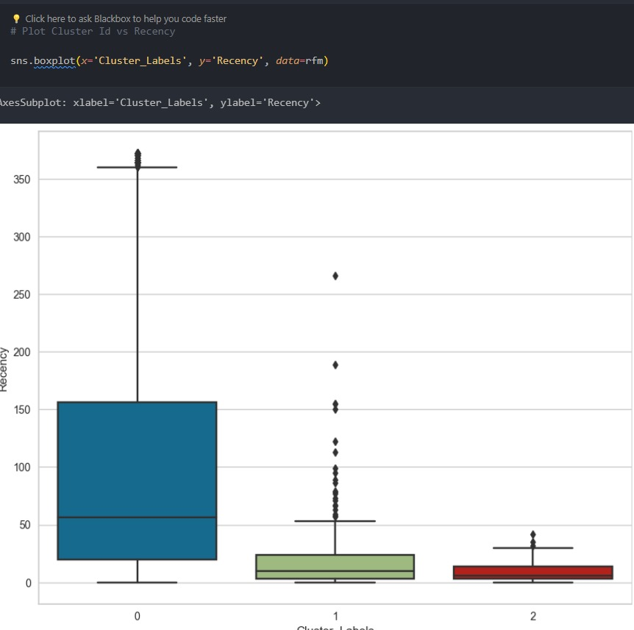
Clustering on online-retai
Cluster Model And Hierarchical

Slide 25
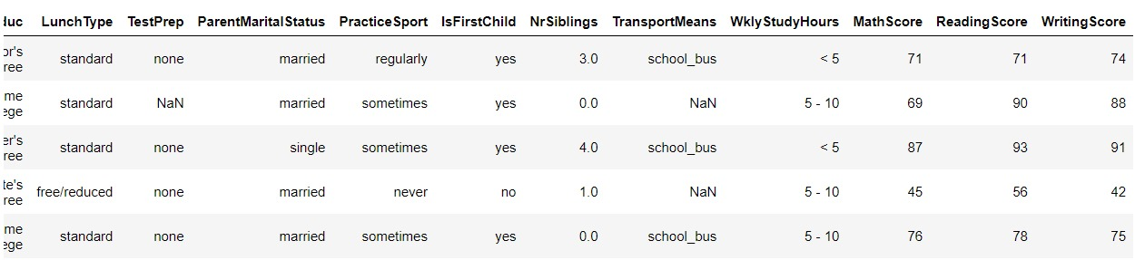
Regression on student score
The dataset
This dataset includes scores from three test scores of students at a (fictional) public school and a variety of personal and socio-economic factors that may have interaction effects upon them.

Slide 26
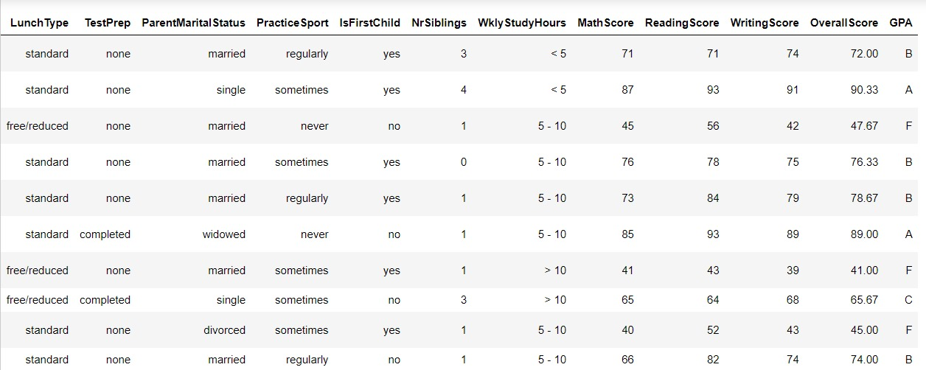
Regression on student score
preprocessing

Slide 27
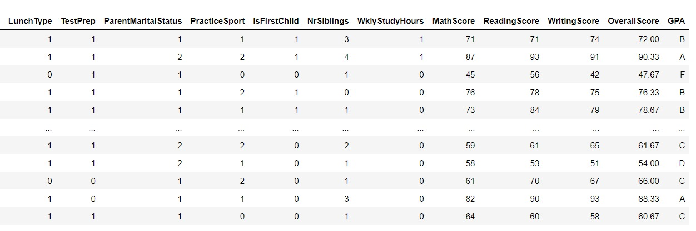
Regression on student score
preprocessing
Label encoding

Slide 28
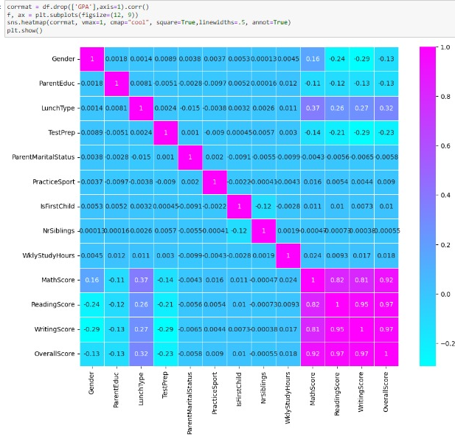
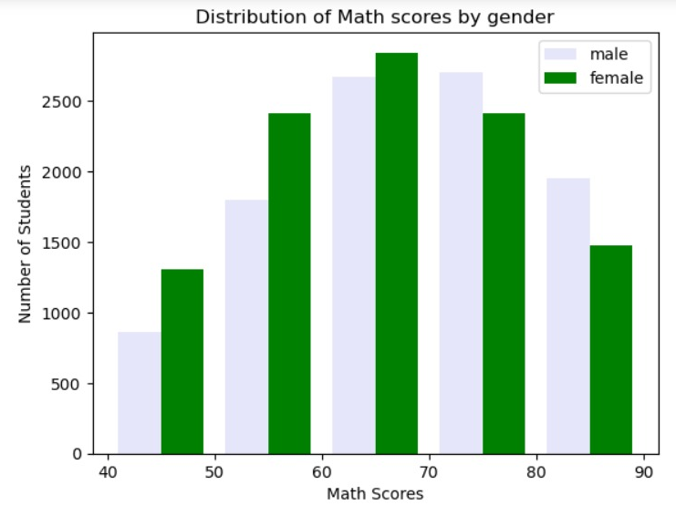
Regression on student score
preprocessing

Slide 29
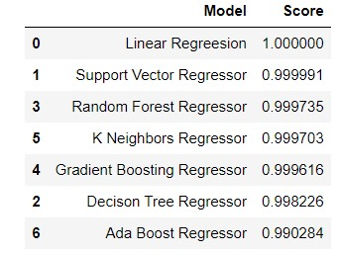
Regression on student score
SVM After tuning
Models
R-squared (R2): 0.9958624214945115Mean Squared Error (MSE): 0.8477222400326211
Before
After
Accuracy: 0.9999910447242925 Mean Squared Error: 0.0018347896898761663

Slide 30
ONE MORE THING

Slide 31


Slide 32
Thank you
Machine Learning
Fady Sameh
Omar Mustafa
Moustafa Karam
Bassema Abdel Razek
Ahmed Mohamed Sofi
Ahmed Mohamed Abdel Salam
Under the Supervision of :
DR. Ali Hamza
Eng. Ahmed Nousir

